Slide 1
Dart Scoreboard SDP
Tyler Ball, Anthony Dohogne, Ben Houser, and Marshall Rosenhoover

Slide 2
Team Members
Marshall Rosenhoover - Technical Lead
Ben Houser - Tools Lead
Anthony Dohogne - Team Lead
Tyler Ball - CM Lead
Kelly Sparks - Technical Writer
LJ Rhodes - Technical Writer

Slide 3
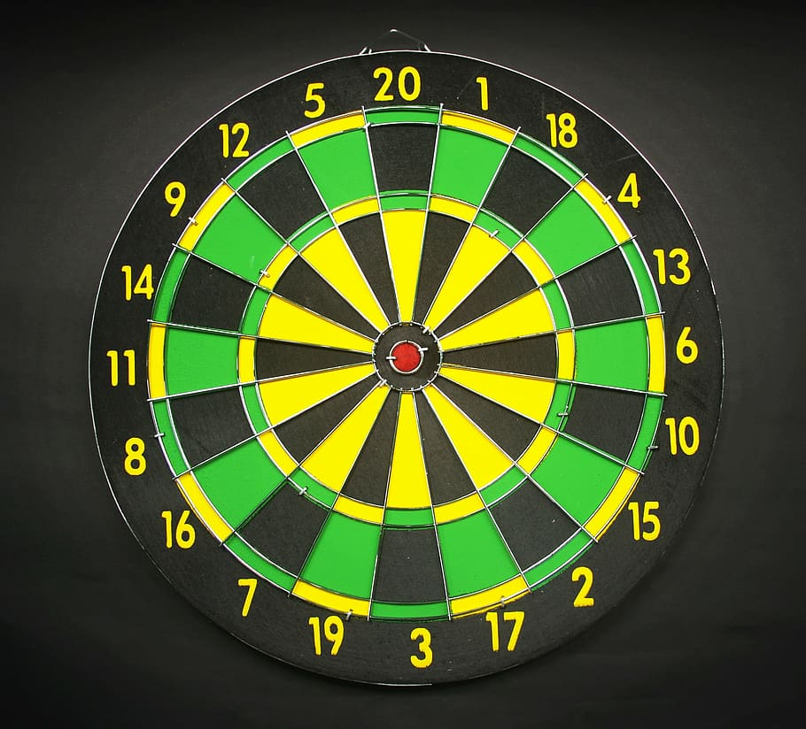
Project Overview
Software to display a dart scoreboard & track dart scores
Scorekeeper uses a GUI to enter in dart throws
Software keeps track of player statistics in a persistent database
Software displays interesting statistics on the scoreboard
Scorekeeper can enter player information using a GUI
Scorekeeper can select match & tournament information
Notes:
Marshall

Slide 4
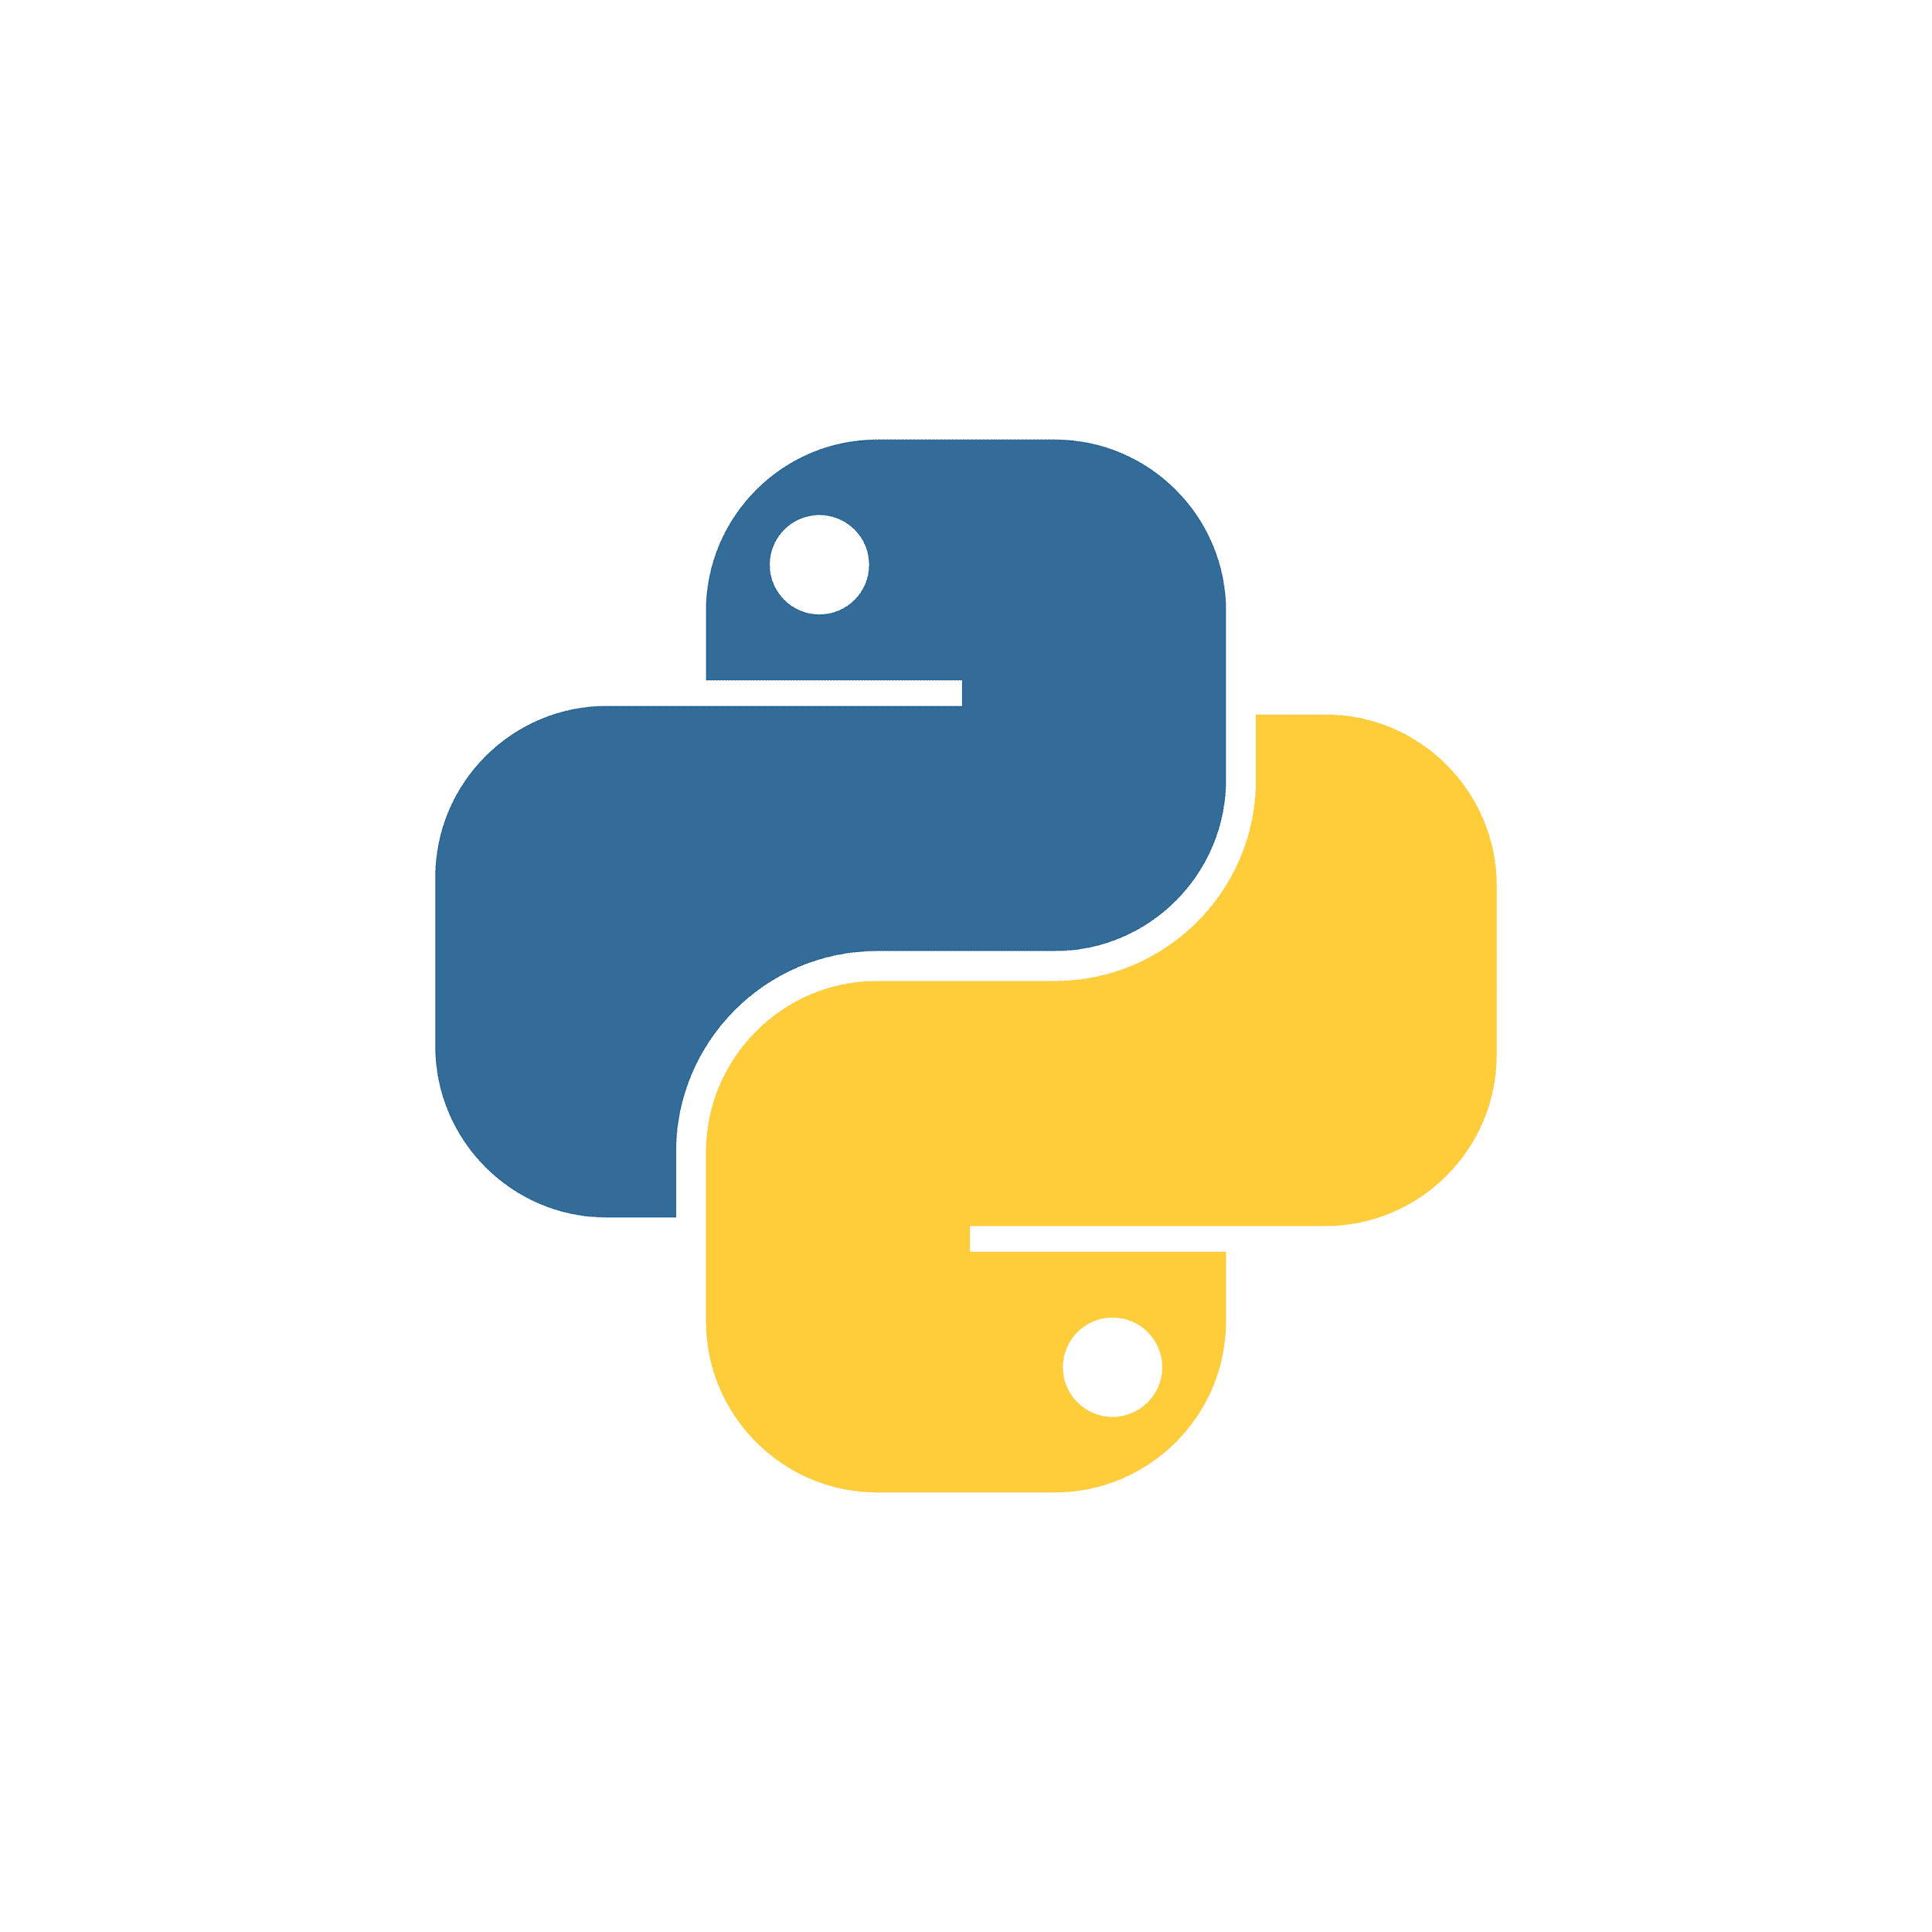
Key Decisions
Use Python as the primary development language
Use GitHub for version control
Use ClickUp for project management
Use Discord for team communication
Meet online due to busy schedules
Notes:
Marshall

Slide 5
Epics & Sprints
Documentation Prep
Front-end Development
Back-end Development
Testing & Verification
Sprint 1 - Planning and Documentation
Sprint 2 - Base Prototype
Sprint 3 - Detailed Prototype
Sprint 4 - GUI Prototype
Sprint 5 - Testing
Notes:
Marshall

Slide 6
User Stories
As a scorekeeper, I can use a menu to set up match info (player names, number of legs, date, etc)
As a scorekeeper, I can enter in throws using a dartboard GUI to update the scoreboard.
As a user, I want player information saved between uses of the application.
As a user, I want the application to calculate winning throws.
Notes:
Mention that this is abridged, more details in SDP
Ben

Slide 7

Risks
Sickness - High
Alternate engagements - Very High
Lack of experience - Medium
Loss of team members - Very Low
Loss of Data - Low
Equipment Failure - Low
Notes:
Present plans for these risks
Ben

Slide 8
Tasks
Training & Research
Update Documentation
Fulfill Team Role Responsibilities
Commit and Push Changes to GitHub
Test and Debug Code Additions
Update Weekly Report
Notes:
Ben

Slide 9
FIN
Notes:
Summarize

